Slide 1

Spotify Analysis
Metrics correlation
PROJECT 1
Search
Home
Library
By David Lara Rene Mondragon
Ivan Chavez Miguel Vargas
Notes:
1-7

Slide 2
Table of contents
01
02
03
Context
Data cleaning
The dataset chosen, main objective and metrics description
Description of the data cleaning and merging code
Hypotheses
Queries, code description and findings from analysis

Slide 3

01
Context
The original dataset was obtained from kagle and tracked the top 50 per country per day for the month of october.
Why the spotify dataset?
Provided several metrics to analyze.
Explore cultural differences.
Recent data and verified.

Slide 4

Our main goal: Explore regional differences and variable correlation
Explore cultural differences by region, taking popularity and ranking as the standard for our analysis and find interesting correlations between metrics.

Slide 5
Metrics definitions
Danceability
Valence
Based on various elements returns the suitability of the song for dancing (0-1)
Likelihood of a song to make the listener happy (0-1)
Popularity
Tempo
Algorithm that measures the growing listener base for a song (0-100)
Estimated tempo in beats per minute of a given track (BPM)
Energy
Liveness
Measure of intensity and activity (0-1)
Detects the presence of live audience in the recording (0-1)

Slide 6


Inquiries
Correlation with popularity
Is there a variable that influences popularity strongly?
Explicitness and popularity
Which are the regions that listen more heavily themed music.
Danceability and region
Which are the regions that prefer highly danceable songs.

Slide 7


Inquiries
Top 1 analysis
Are there common attributes amongst the top 1 song in each country?
Top artist by region
Based on popularity (not rank) which is the most popular artist

Slide 8
01
One Day Selection
Data cleaning
Search
Home
Library
¿Why?
Notes:
IVAN 8-13

Slide 9
Countries selection by region
-Asia
Republic of Korea
Taiwan
Singapore
-LatinAmerica
Mexico
Colombia
Chile
-Europe
France
United Kingdom
Romania
-NorthAmerica
USA
Canada

Slide 10
DATA CLEANING
Step by step
Search
Home
Library

Slide 11
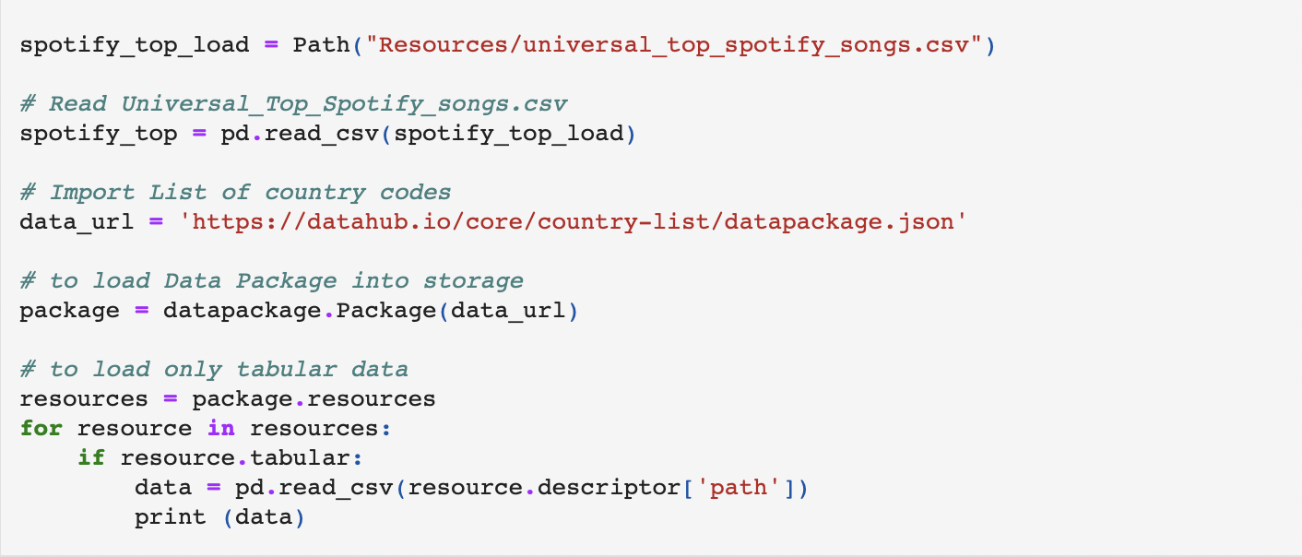
#Import work

Slide 12
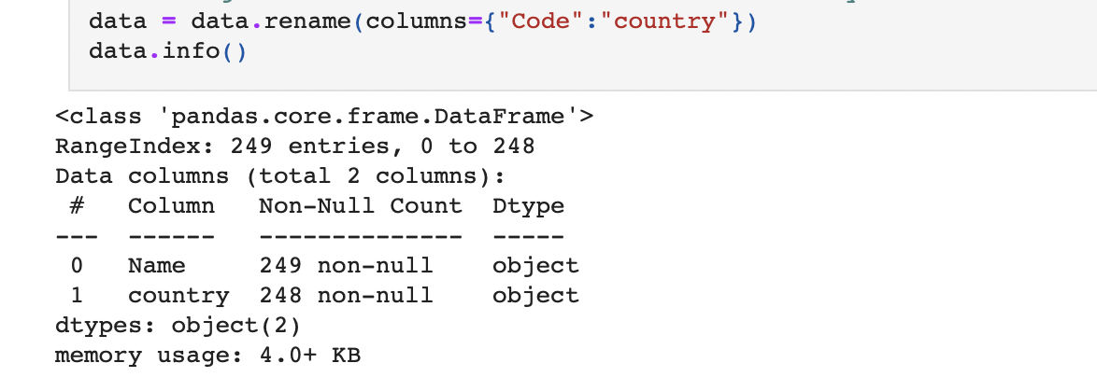
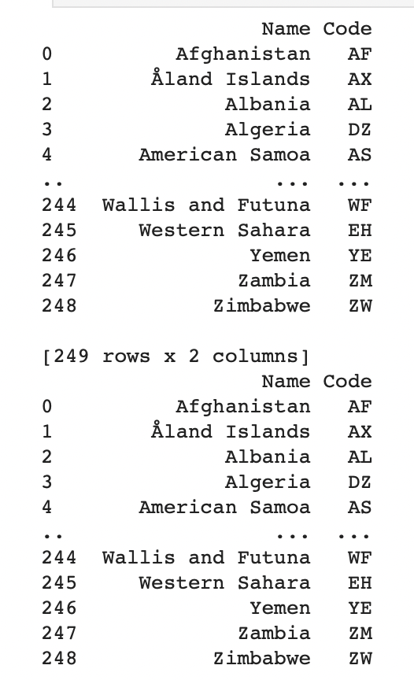
#Change the name of the ‘code’ column to country

Slide 13
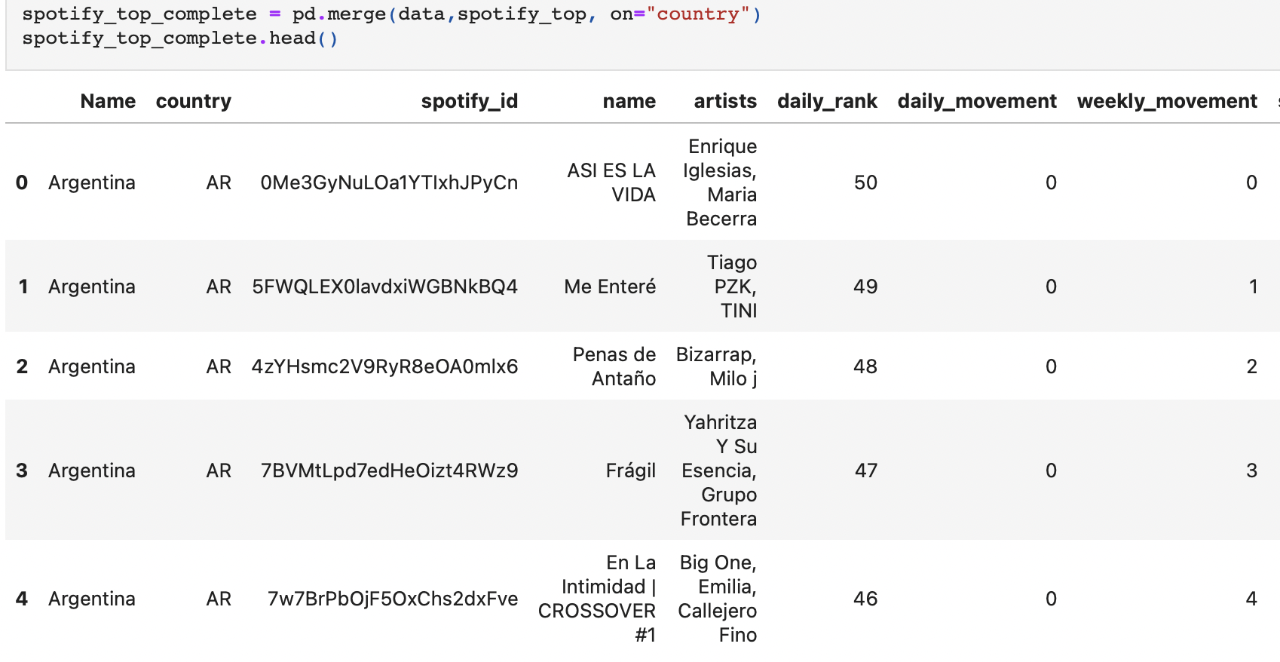
#Merge the data set on the country column

Slide 14
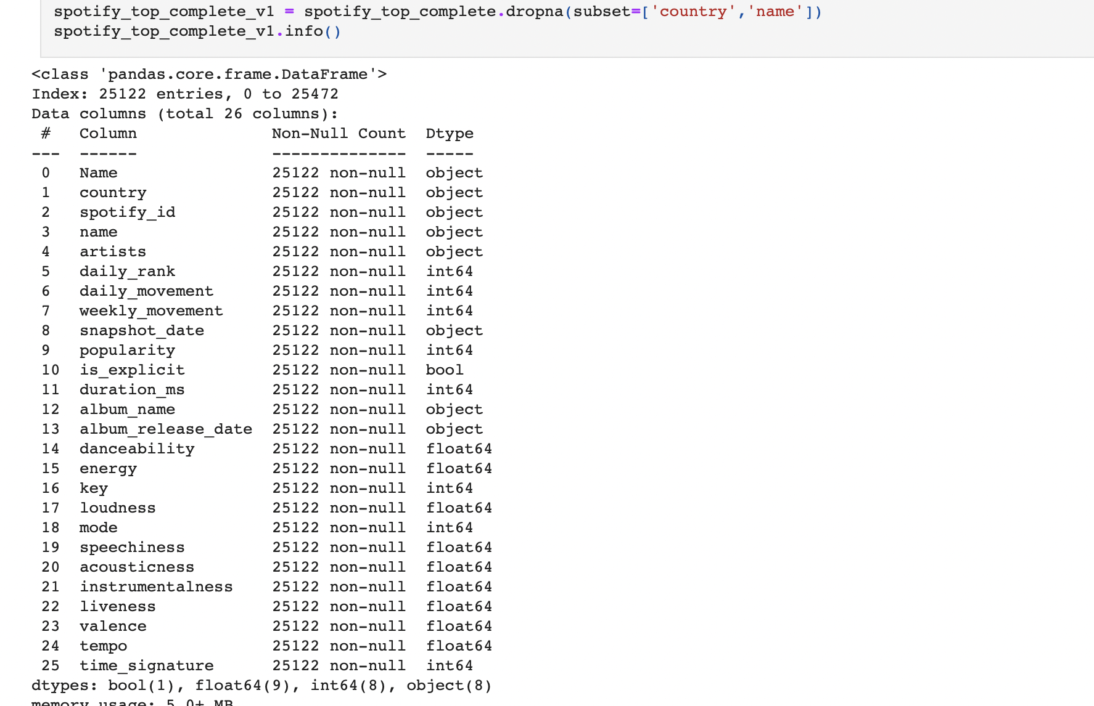
# Use .dropna method to remove missing value
Notes:
RENE 14-15

Slide 15
#Remove data with a different “snapshoot_date” from “24-10-23” and store the data on spot_top_complete
#Remove any data with values different from the ones in the "countries" list.
#Display the clean Data

Slide 16
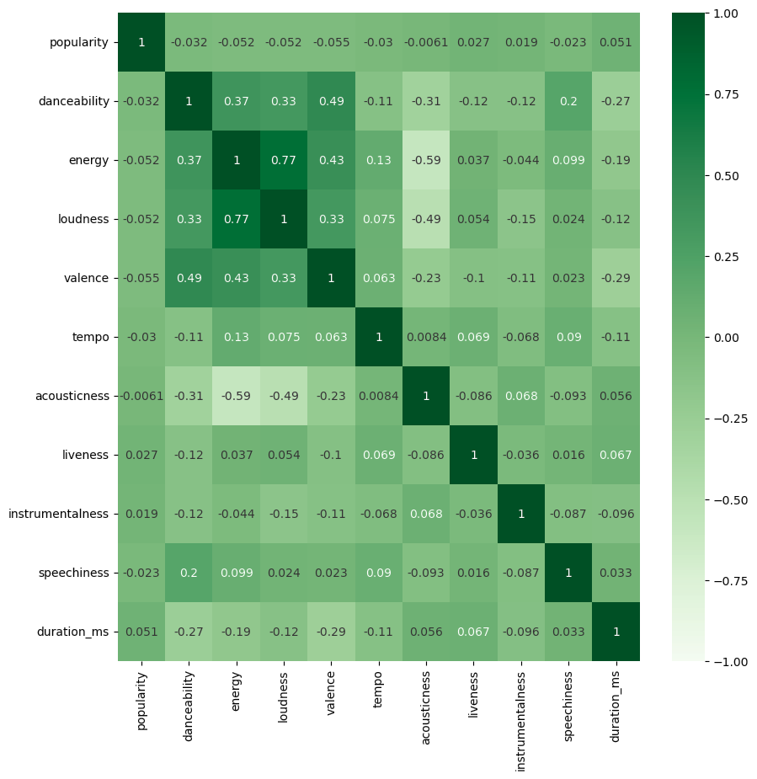

KPI´s HeatMap Correlation
Strongest Correlation:
Energy vs Loudness
P. Value 0.77
Danceability vs Valance
P. Value 0.49
Energy vs Valance
P. Value 0.43
Loudness vs Danceability
P. Value 0.33
Notes:
MIKE 16-19

Slide 17
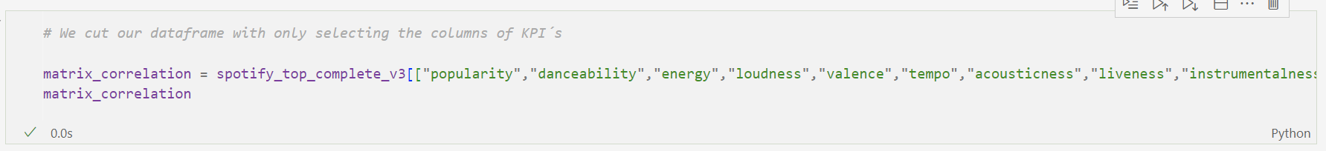
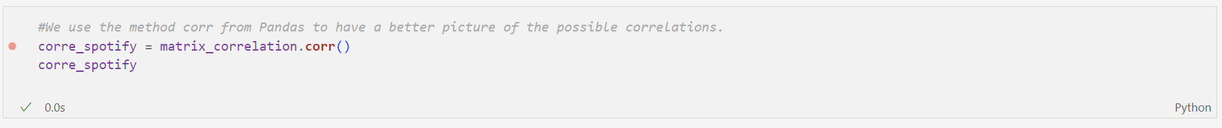
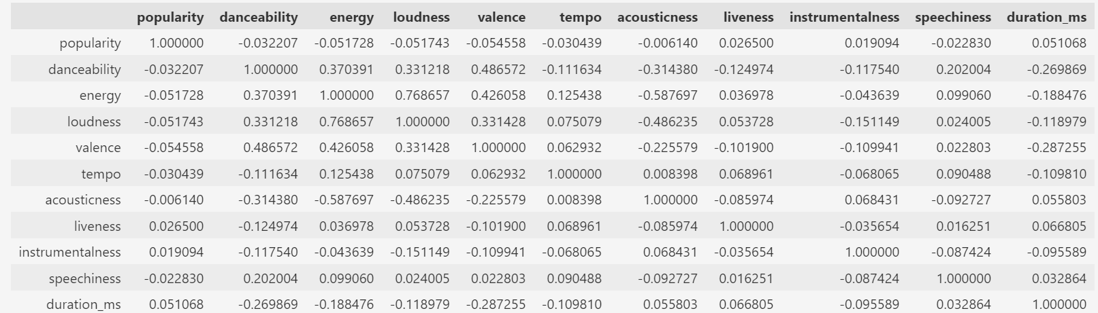
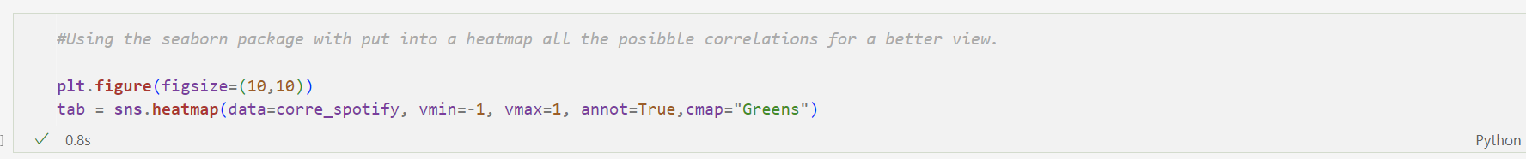
Heat Map code
The code:

Slide 18
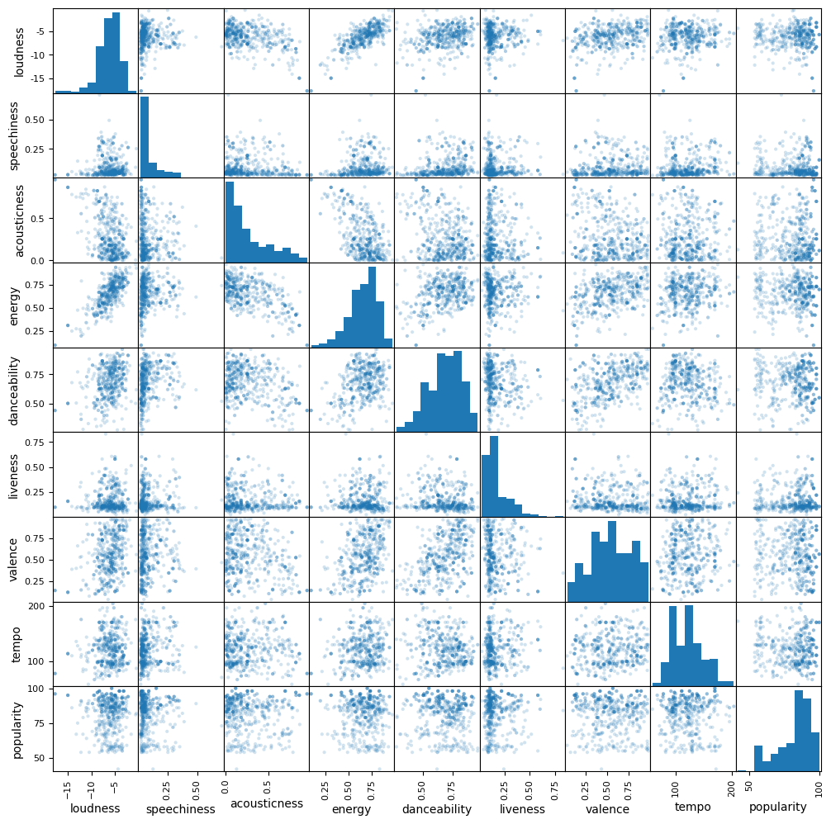
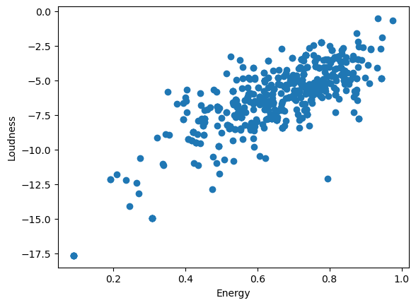
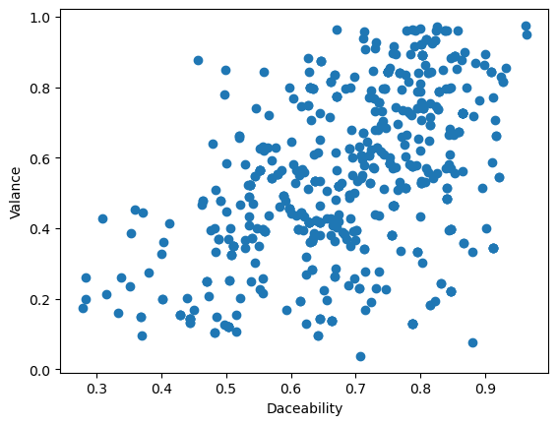
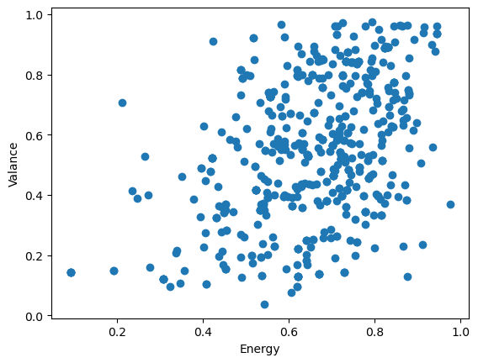
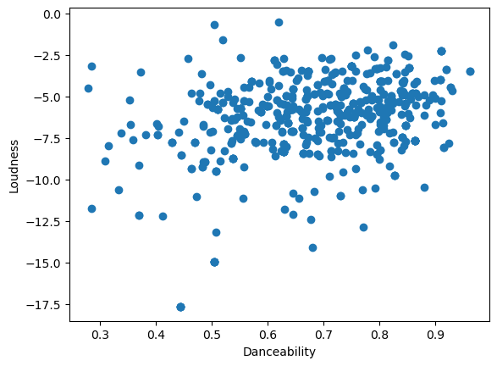
Scatter Plot Matrix
Loudness vs Energy
Valance vs Danceability
Valance vs Energy
Loudness vs Danceability

Slide 19
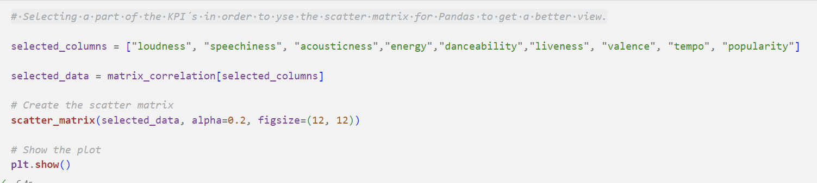
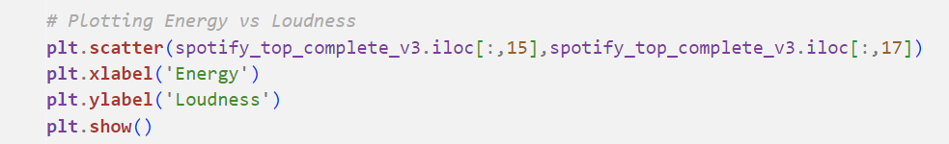
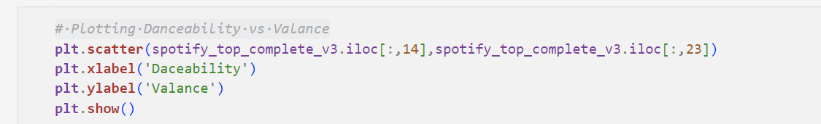
Scatter Plot Code
The code:

Slide 20
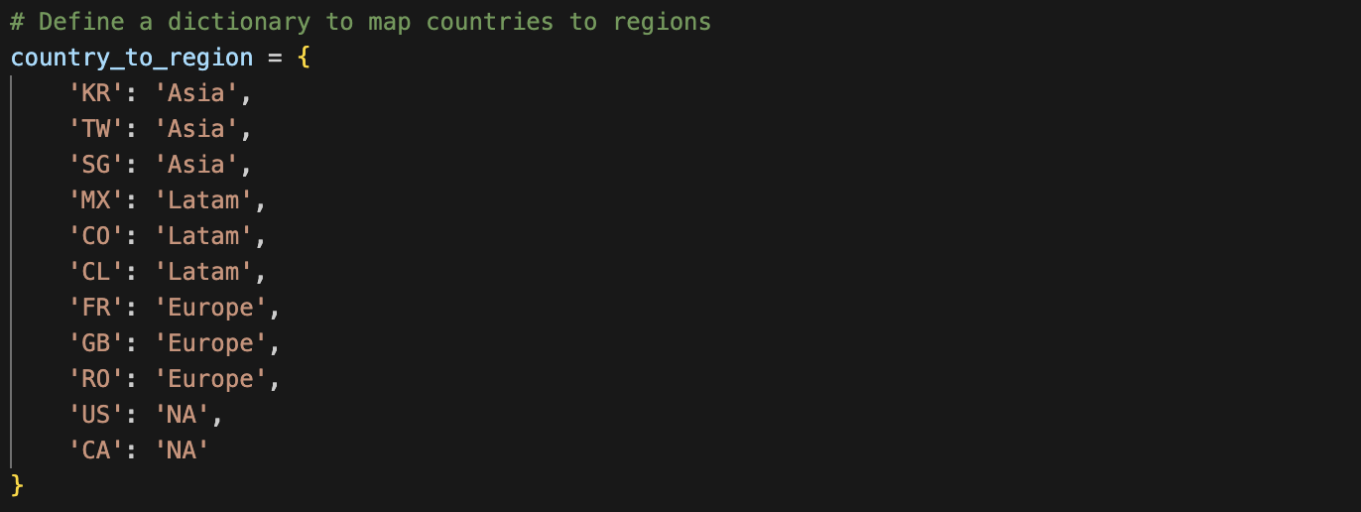
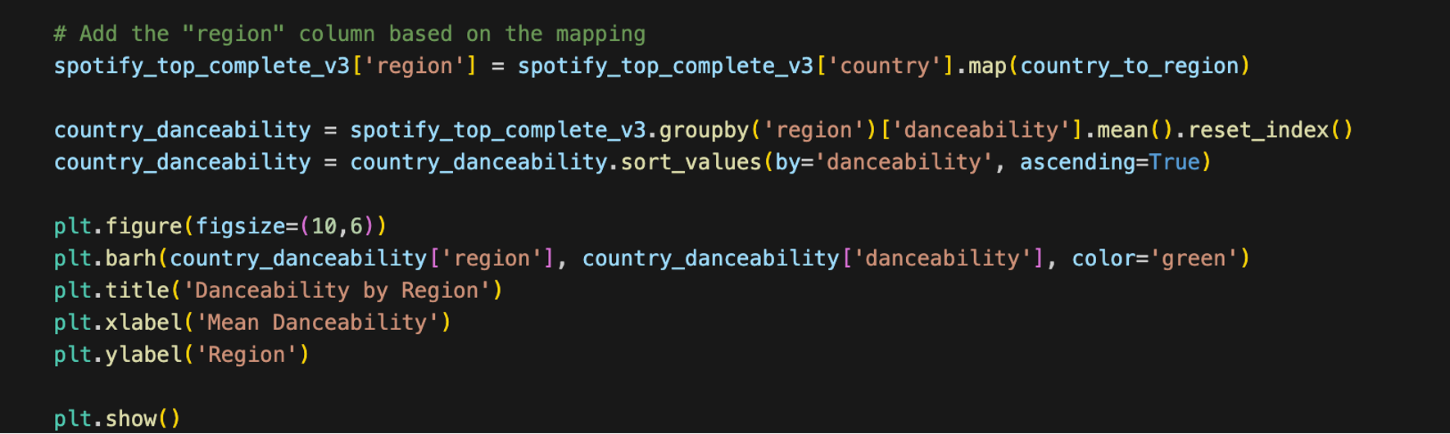
Danceability and region
The code:
Notes:
RENE 20-21

Slide 21
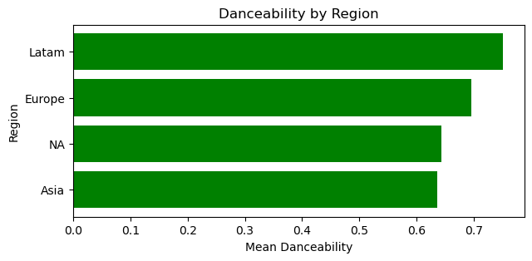
Is there a difference between regions?

Slide 22
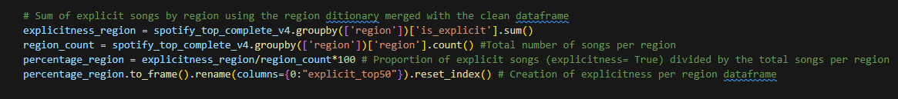
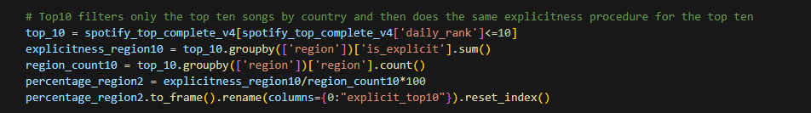
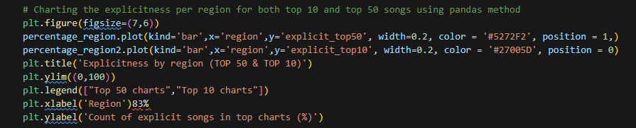
Explicitness per region:
Which are the regions that listen more heavily themed music.
The code:
Notes:
DAVID 22-24

Slide 23
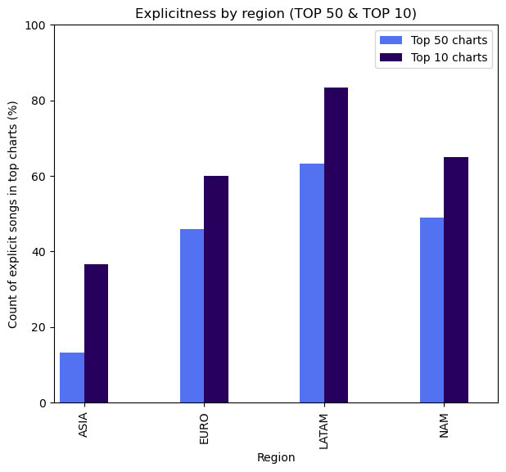
Explicitness per region
LATAM
63%
ASIA
13%
83% of the top 10 are explicit songs
36% of the top 10 are explicit songs
EURO
46%
N-AM
49%
60% of the top 10 are explicit songs
65% of the top 10 are explicit songs

Slide 24

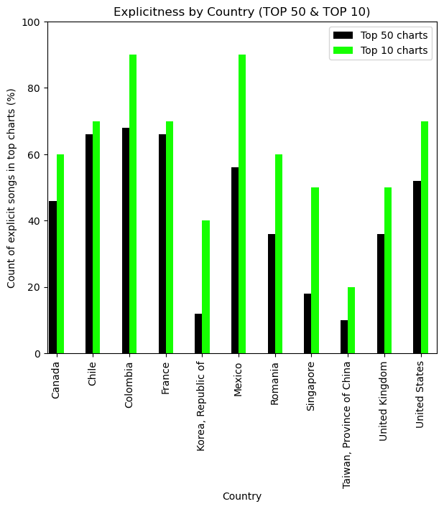
Explicitness by country
The region that has more explicit songs in the top 50 and top 10 is latinoamerica and the region with the least explicit songs is Asia.

Slide 25
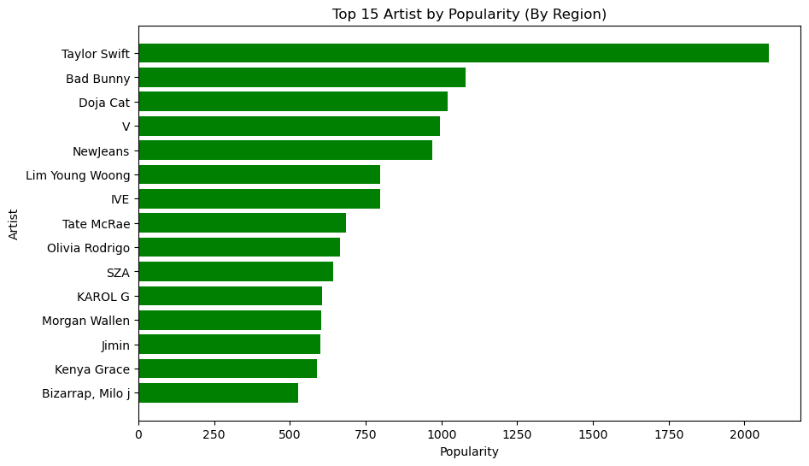
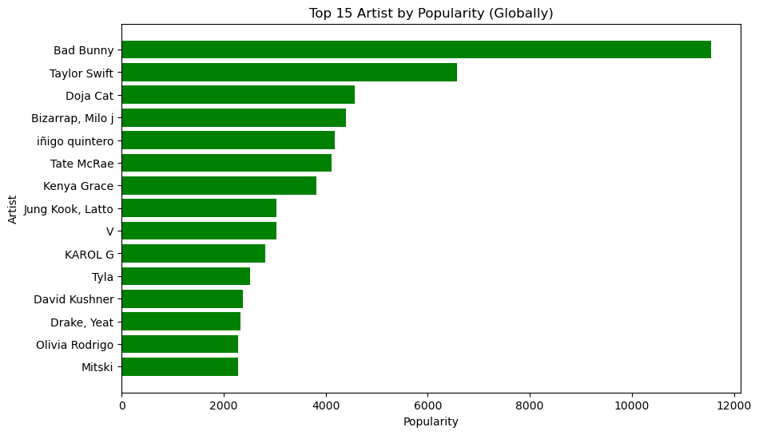
Top artist by region
Globally:
1.- Bad Bunny: 11,554
2.- Taylor Swift: 6,572
Our sample:
1.- Taylor Swift: 2,081
2.- Bad Bunny: 1,081
Notes:
RENE 25-27

Slide 26
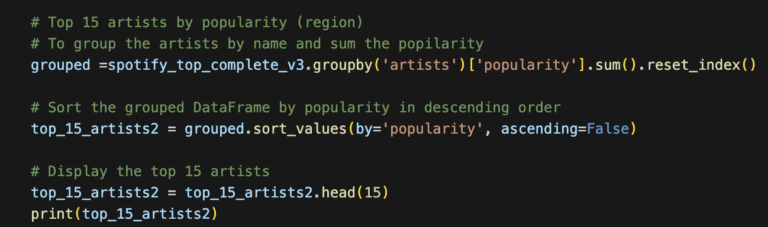
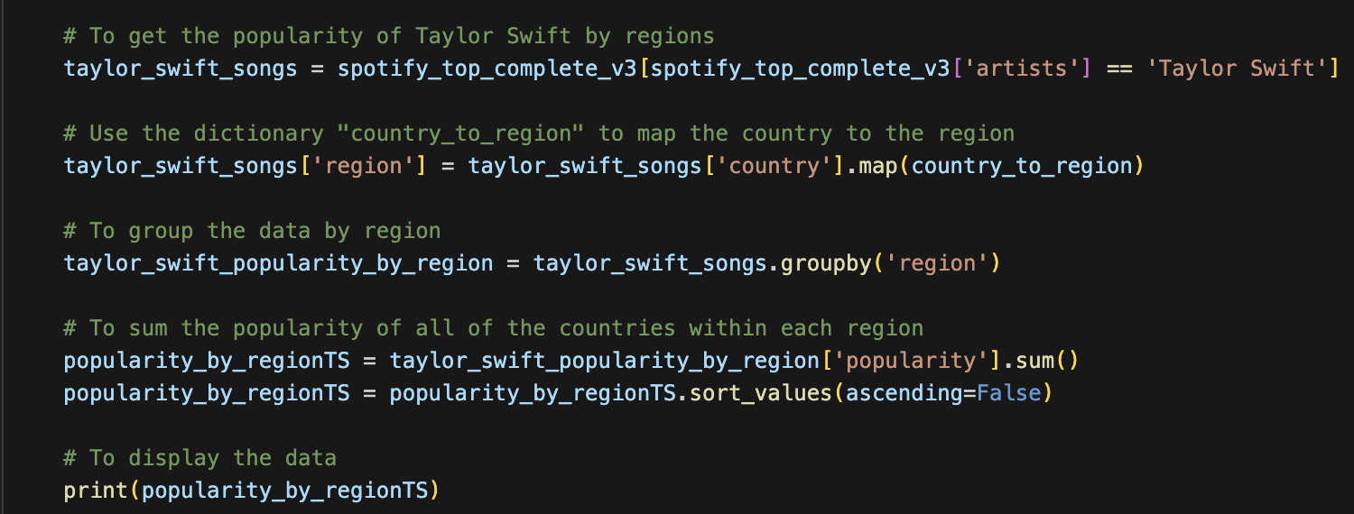
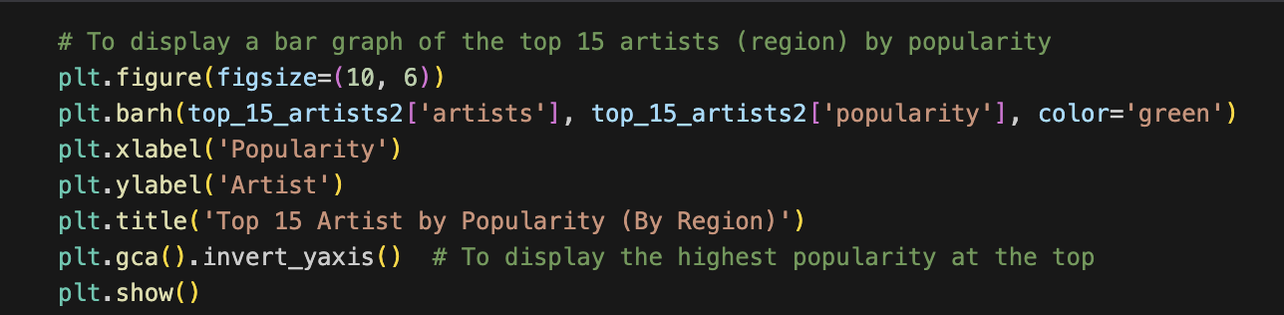
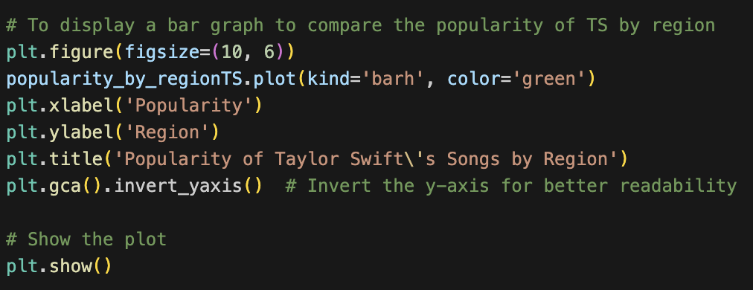
Top artist by region
The code:

Slide 27
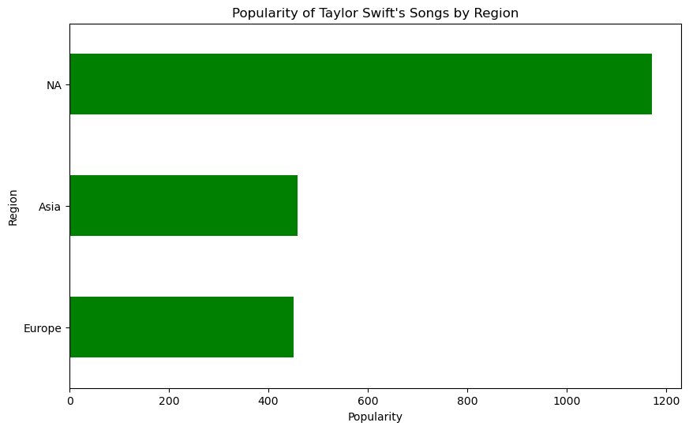
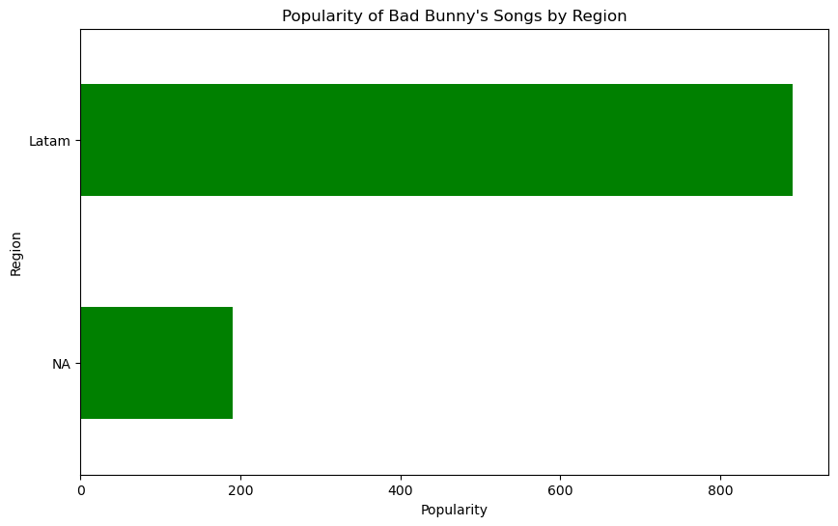
Top artist by region
Taylor Swift
Bad Bunny
1.- North America: 1,172
2.- Asia: 4,59
3.- Europe: 450
4.- Latam: N/A
1.- Latam: 891
2.- North America: 190
3.- Europe: N/A
4.- Asia: N/A

Slide 28
TOP 1 Attributes in common
(countries selection)
#1
#6
#2
#7
#3
#8
#4
#9
#5
#10
Perro negro- bad bunny
Que Onda- calle 24
Colombia
Mexico
Ando-Jere Klein
IDGAF- Drake
Chile
United States
IDGAF- Drake
Cleopatra-IDK
Canada
Romania
Petit Genie-Jungeli
Seven- Jung Kook
France
Singapore
Seven- Jung Kook
Seven- Jung Kook
Republic of Korea
Taiwan
Notes:
IVAN 28-30

Slide 29
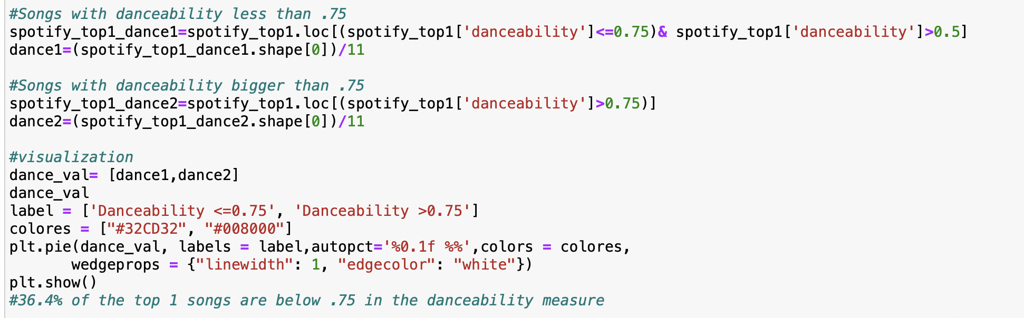
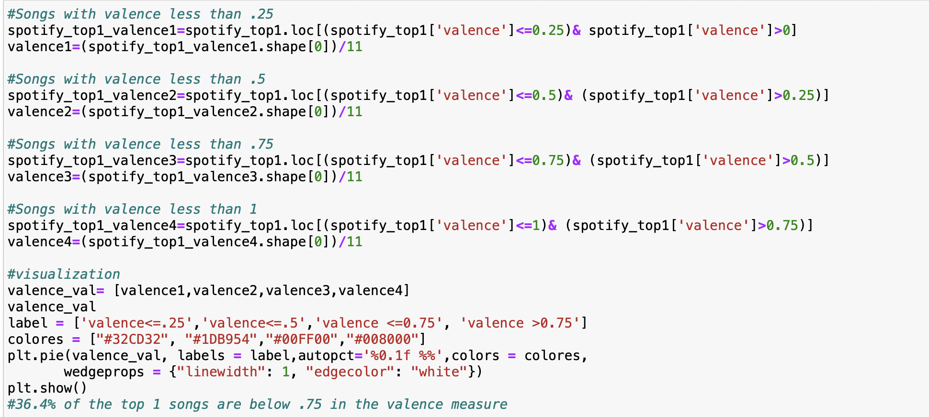
Danceability, Energy and Valance
The code:

Slide 30
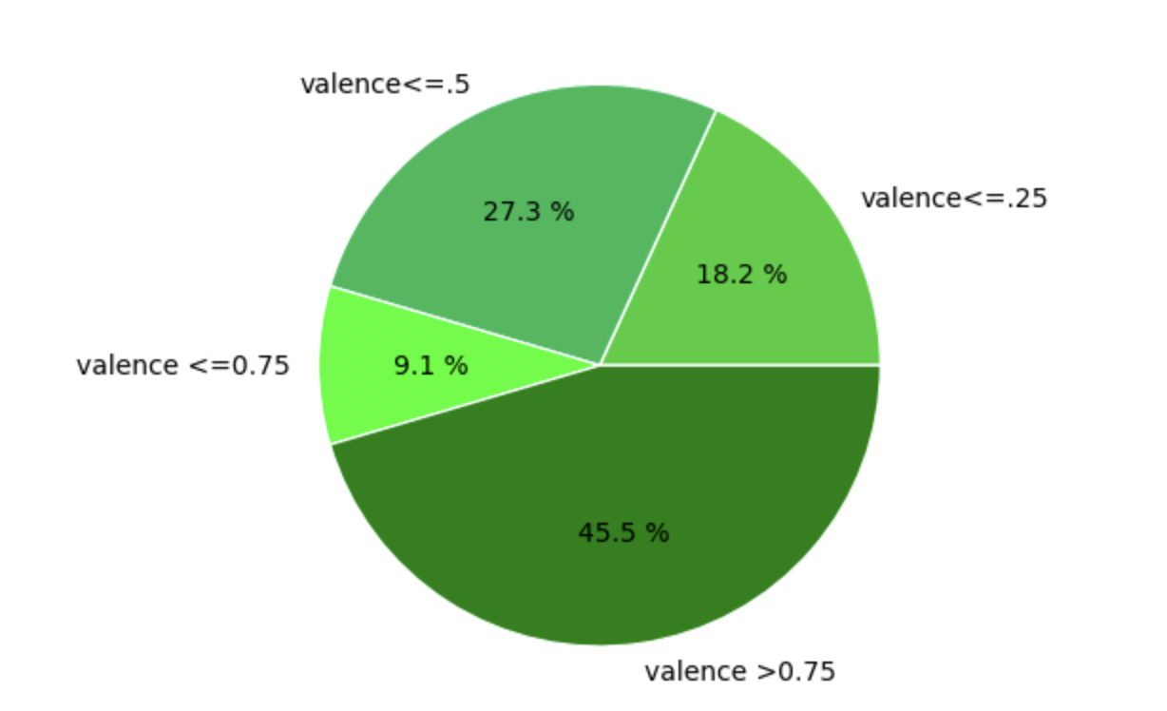
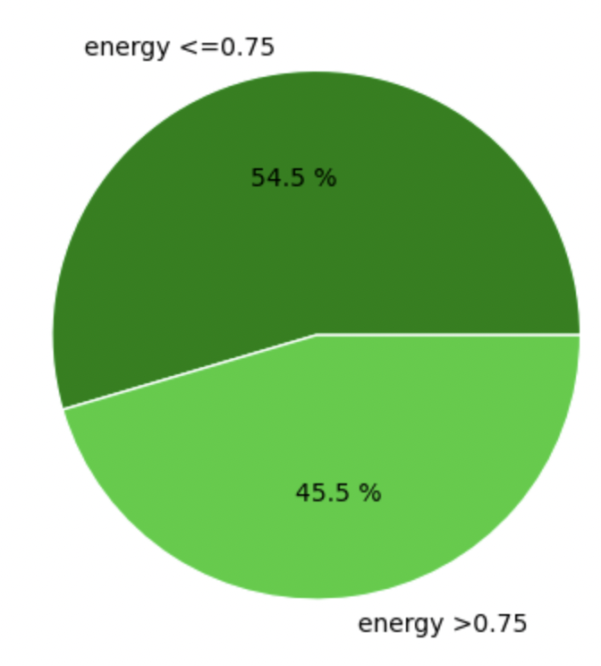
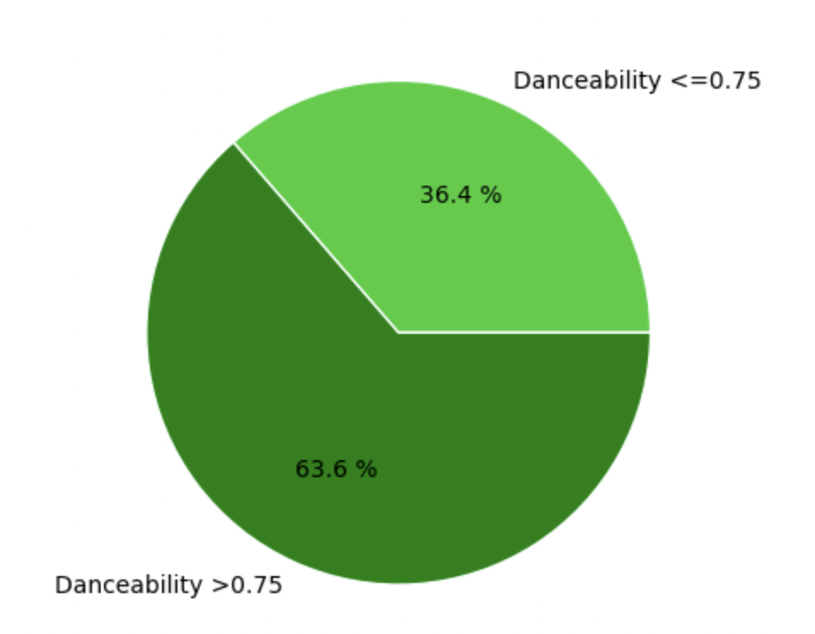
Valence
Energy
Danceability

Slide 31
Conclusions
Actually, we were not able to determine any correlation for popularity, so we concluded that the popularity it is no related to any of the attributes of a song.
We found that a song that wants to reach the Top 1,needs to have the following attributes.
Valence - Energy - Danceability
The region that listens to more explicit songs is LATAM with a 83% of explicit songs in the top ten maybe not a surprise. And in the other hand we have ASIA with a 36% in the top ten, they are not great fans of the explicit songs.
Based in the popularity of the artist we have two main artist according to our data set. Taylor Swift and Bad Bunny.
Taylor Swift is the most popular based in our selected countries and Bad Bunny is the most popular artist taking in account the hole dataset of 73 countries.

Slide 32
Thanks!
Our Music Playlists
Search
Home
Library
Do you have any questions?
Notes:
MIKE

